Slide 1
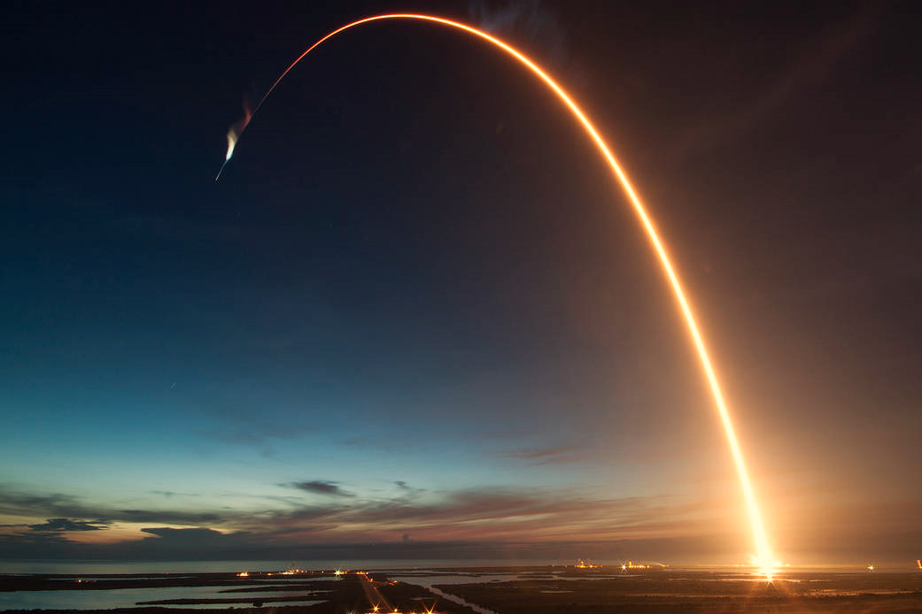

Winning Space Race with Data Science
Chirag Jain
21.12.2024

Slide 2
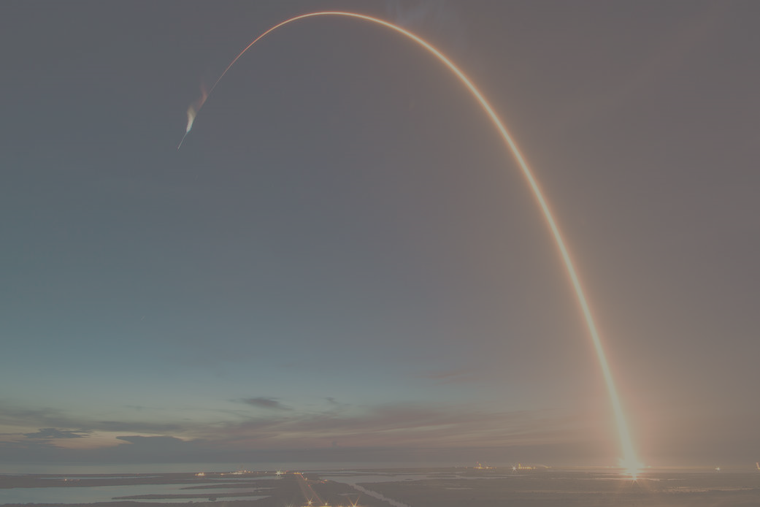
Overview
Executive Summary
Introduction
Methodology
Results
Conclusion
Appendix

Slide 3
Executive Summary
The data was collected with the help of SpaceX API and Wikipedia, which underwent data preprocessing, selection and integration to obtain the required attributes. To understand the data, data visualization libraries and SQL were used for Exploratory Data Analysis. Folium library was used to map the locations of each launch site along with its corresponding successful and unsuccessful launches, and distance from coastline, nearest city and highway. All the visualizations were displayed via a Dash App. Afterwards, comparative predictive models were built to identify the best model to predict a successful launch of a Falcon 9 rocket.
K Nearest Neighbour was identified as the best model to predict the success of a launch from sites with an accuracy of 90.35% on test data. Further improvement in processing algorithm could benefit the model to perform relatively better than now.

Slide 4
Introduction
SpaceX is a billion-dollar private space corporation, specializing in rocket manufacturing and launching. Falcon 9, a commercial rocket known for its reusability, is a medium-lift launch vehicle. In this capstone, we will be conducting a time-series analysis and create a prediction model on the success of its launch based on the dataset acquired via SpaceX API and Wikipedia.
Falcon 9 costs about 62 million dollars, relatively lower than its competitors (165 million dollars) for commercial use. Hence, determining the successful landing rate of the first stage will help give insight to alternative start-ups/MNCs to bid against SpaceX for rocket launches.
The main question, we would be answering is, whether the Falcon 9 rocket lands successfully based on the payload mass, orbit type, launch site and so on ?

Slide 5
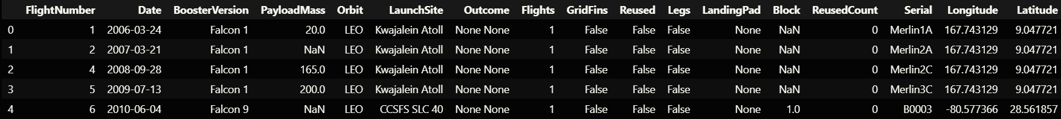
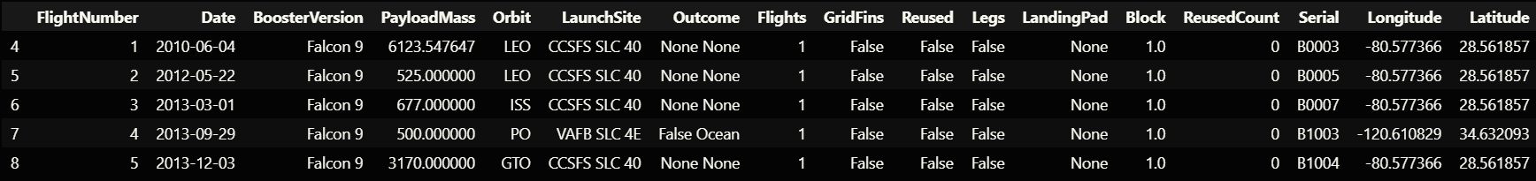
Methodology
Data Collection
We acquired the data on SpaceX rockets from the SpaceX API ( https://api.spacexdata.com/v4/rockets/ ), which was then filtered to extract only Falcon 9 rockets.
We addressed the missing payload mass values by taking the mean of that attribute and replacing missing values with the mean.
Fig.1 Acquired Data from SpaceX API
Fig.2 Dataset after Data Wrangling

Slide 6
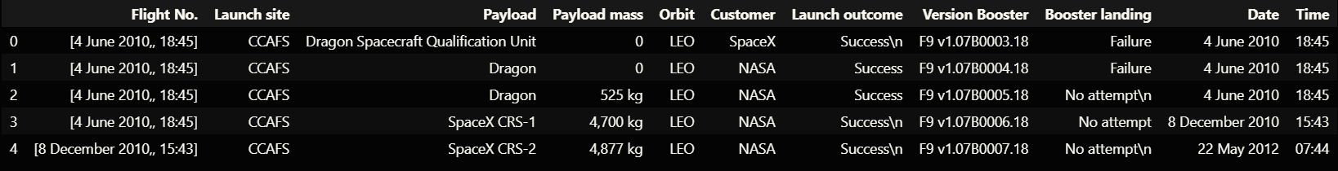
Methodology
Data Scraping
We acquired Falcon 9 launch details from this Wikipedia Page . We gathered data on the flight date, launch site, payload details, payload mass, expected orbit, customer, launch outcome, and booster version.
We used Request library to access the Wiki page and Beautiful Soup to scrape and parse it, and stored it in a dataframe for further use.
Fig.3 Scraped dataset from Wikipedia

Slide 7
Methodology
Data Wrangling
In this process, from the launch outcome and booster landing, we are inferring whether the launch was successful or not. On that basis, we are identifying the success rate for each launch site.
We create a class consisting of 0’s and 1’s, indicating whether the launch was successful or not. This will be useful while building the prediction model.
In the end, we have a dataset containing 90 rows and 18 attributes, ready for exploratory data analysis.

Slide 8

Methodology
Exploratory Data Analysis
SQL (sqlalchemy) - The data is acquired using SQL query to perform the following task:
Identify the names of launch sites.
Display records where launch sites’ name starts with “CCA”.
Display total payload mass carried by boosters launched by NASA(CRS)
Display average payload mass carried by F9 v1.1 booster
List the date when the first successful landing outcome on launch pad had occurred.
List the names of the boosters which have success in drone ship and have payload mass greater than 4000 but less than 6000
List the total number of successful and failure mission outcomes
List the names of the booster versions which have carried the maximum payload mass.
List the records which will display the month names, failure landing outcomes in drone ship ,booster versions, launch site for the months in year 2015.
Rank the count of landing outcomes (such as Failure (drone ship) or Success (ground pad)) between the date 2010-06-04 and 2017-03-20, in descending order.

Slide 9

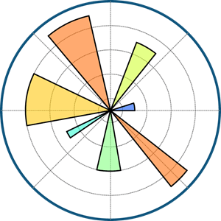
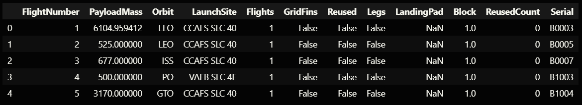
Methodology
Exploratory Data Analysis
Matplotlib and Seaborn – Tasks:
Visualize the relationship between Flight Number and Launch Site
Visualize the relationship between Payload Mass and Launch Site
Visualize the relationship between success rate of each orbit type
Visualize the relationship between Flight Number and Orbit type
Visualize the relationship between Payload Mass and Orbit type
Visualize the launch success yearly trend
Feature Engineering
In this, we discarded irrelevant attributes and reformatted certain attributes to 0’s and 1’s via one hot encoding.
Fig.4 Dataset with selected features before Once Hot Encoding

Slide 10
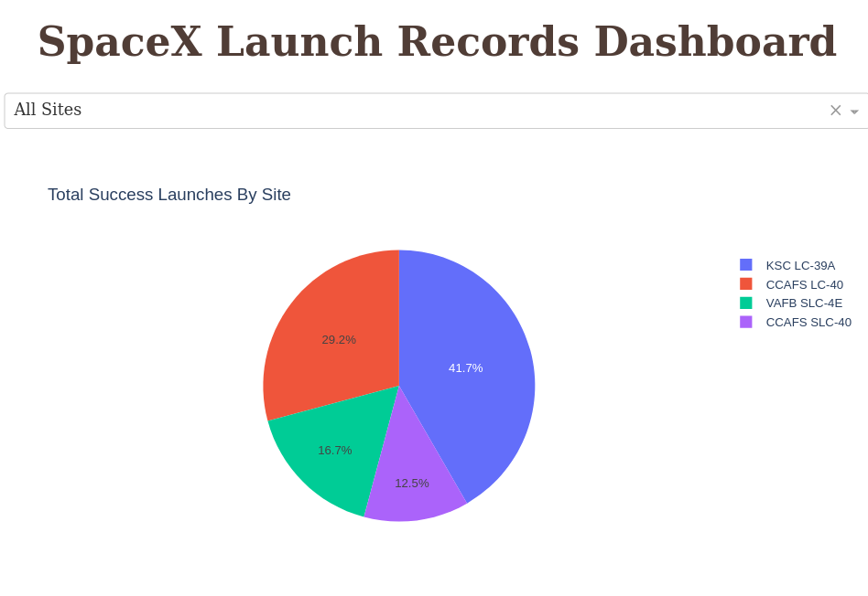
Methodology
Building an Interactive Map Using Folium and Plotly Dash
We used folium library to build an interactive map depicting the locations of launch sites along with markers indicating successful and unsuccessful launches.
We also used Dash application to create a frontend to access the visualizations and interact with it.
Fig.5 SpaceX launch Records Dashboard built using Dash

Slide 11
Methodology
Machine Learning Prediction Model
We built 4 models and conducted a comparative analysis on them to identify the best out of the 4. The models selected were – Logistic Regression, Section Vector Machine (SVM), Decision Tree, and K Nearest Neighbour (KNN).
We standardised the dataset using Standard Scalar function, and separated the dataset into training set and testing set in the ratio of 8:2 with a 2 as the random state value.
Each model was subjected to GridSearchCV to identify the best parameters for that model with Cross-validation set for 10-folds.
The models were done compared against each other based upon their accuracy. KNN model came on top with the best test score (90.35%), where as LR and SVM topped on the training set (83.33%).

Slide 12
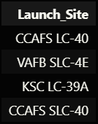
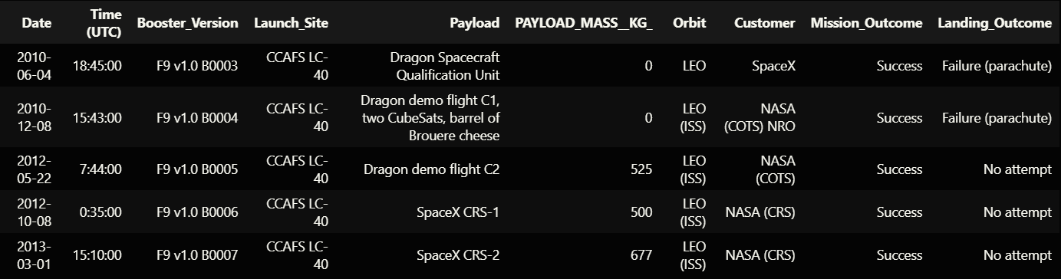



Results
EDA using SQL
Task 1: Unique Launch Sites
Task 2: Displaying 5 records where launch sites’ begin with “CCA”
Task 3: Displaying total payload mass carried by boosters launched by NASA (CRS)
Task 4: Displaying average payload mass carried by boosters (F9 v1.1)
Task 5: List the date when the first successful landing outcome on launch pad had occurred.

Slide 13
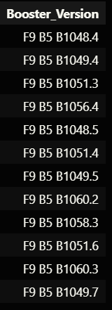
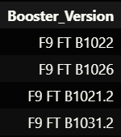

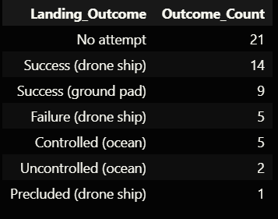
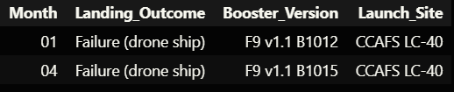
Results
EDA using SQL
Task 7: Listing total number of successful and failure mission outcomes
Task 6: List the names of the boosters which have success in drone ship and have payload mass greater than 4000 but less than 6000
Task 8: Listing the boosters carrying the maximum payload mass.
Task 9: Listing the records with Month, Landing Outcome in Drone Ship, Booster Version, Launch Site in the year 2015
Task 10: Ranking the count of landing outcomes (such as Failure (drone ship) or Success (ground pad)) between the date 2010-06-04 and 2017-03-20, in descending order.

Slide 14
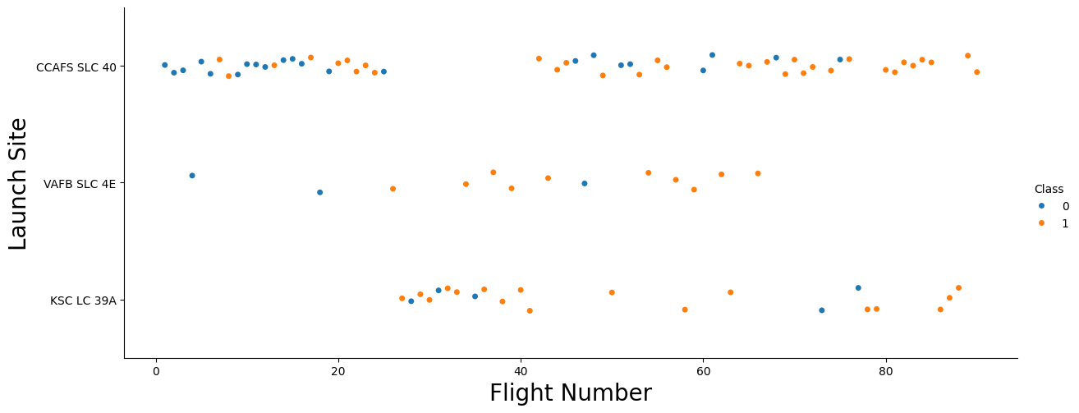
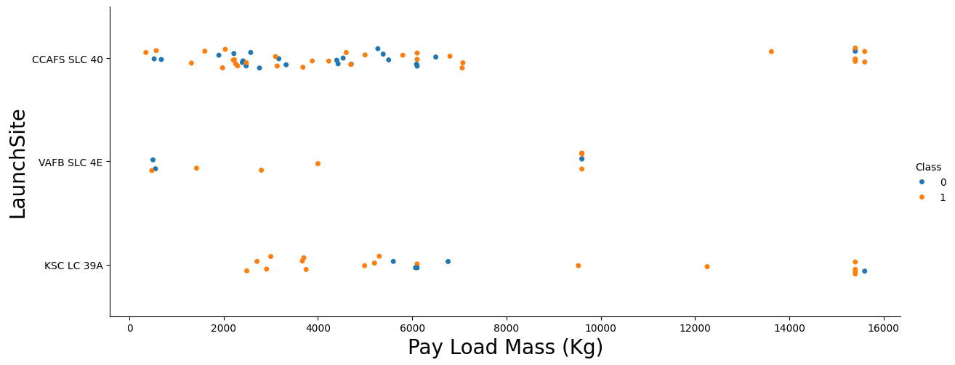
Results
EDA using Matplotlib and Seaborn
Task 1: Relationship between Flight Number and Launch Site
Task 2: Relationship between Payload Mass and Launch Site

Slide 15
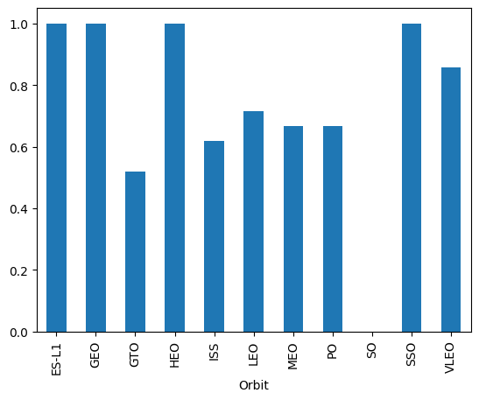
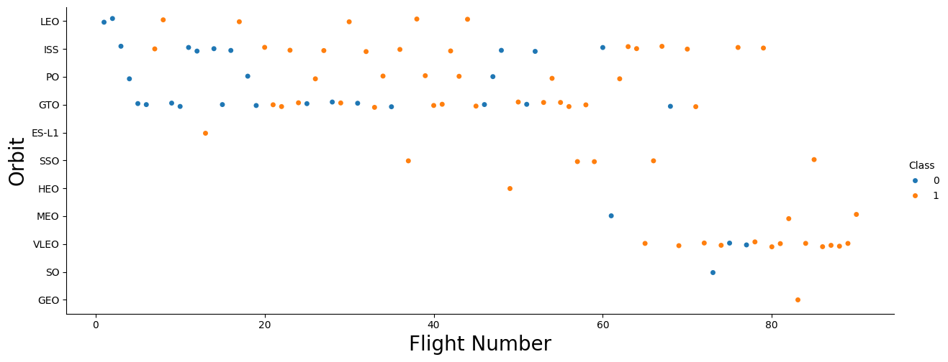
Results
EDA using Matplotlib and Seaborn
Task 3: Visualising success rate of each orbit type
Task 4: Relationship between Flight Number and Orbit type

Slide 16
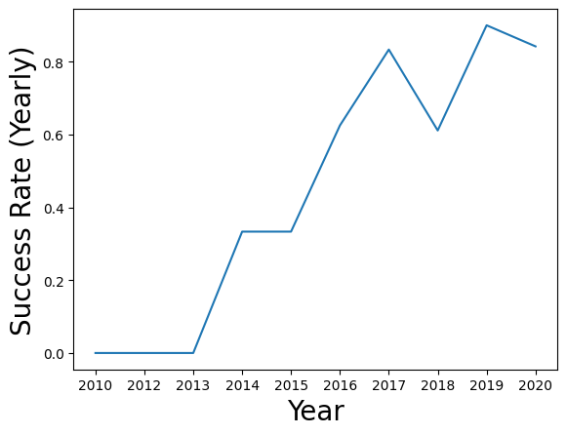
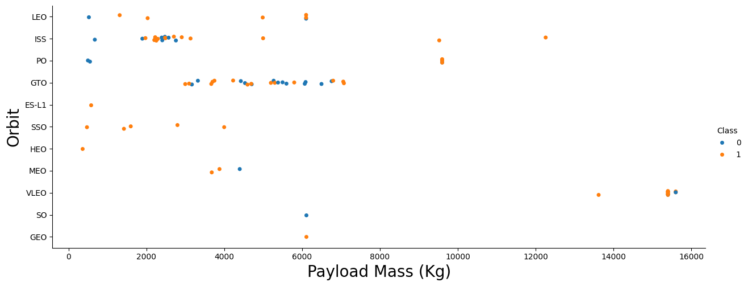
Results
EDA using Matplotlib and Seaborn
Task 5: Relationship between Payload Mass and Orbit Type
Task 6: Visualising launch success yearly trend

Slide 17
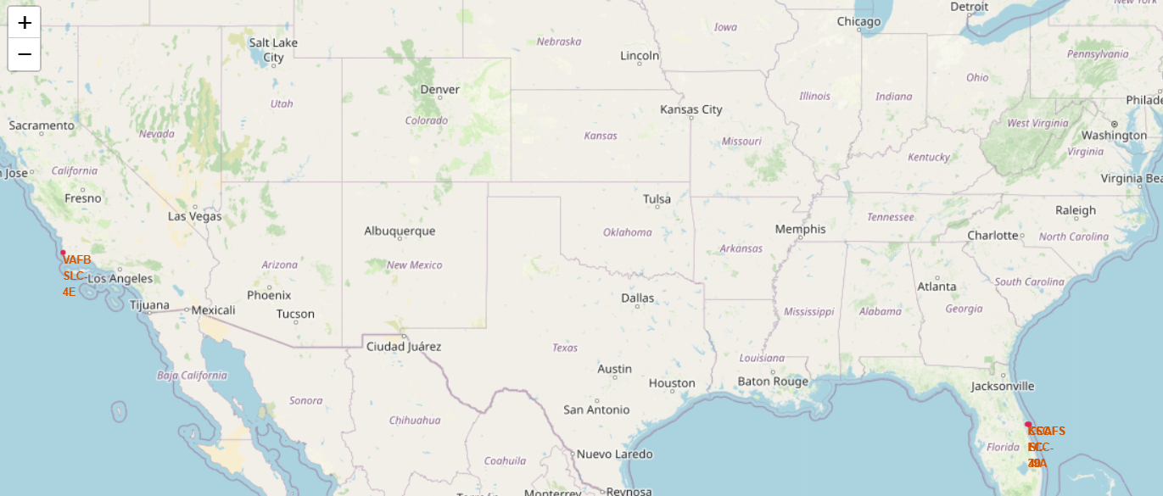
Results
Interactive Visual Analytics using Folium
Task 1: All Launch Sites on the Map

Slide 18
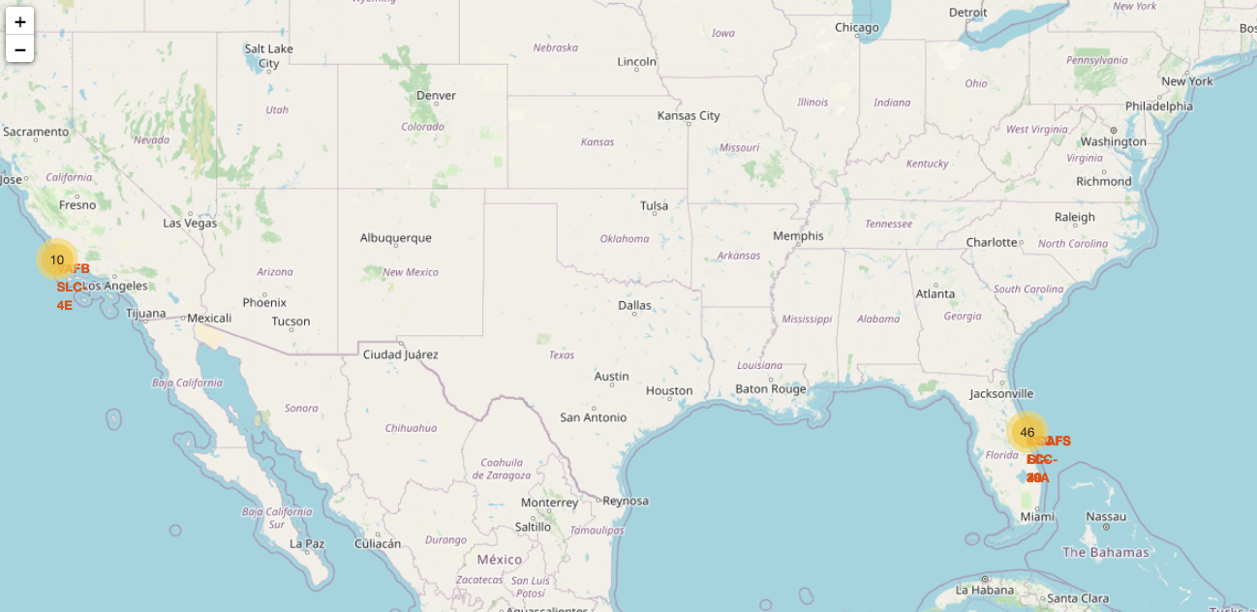
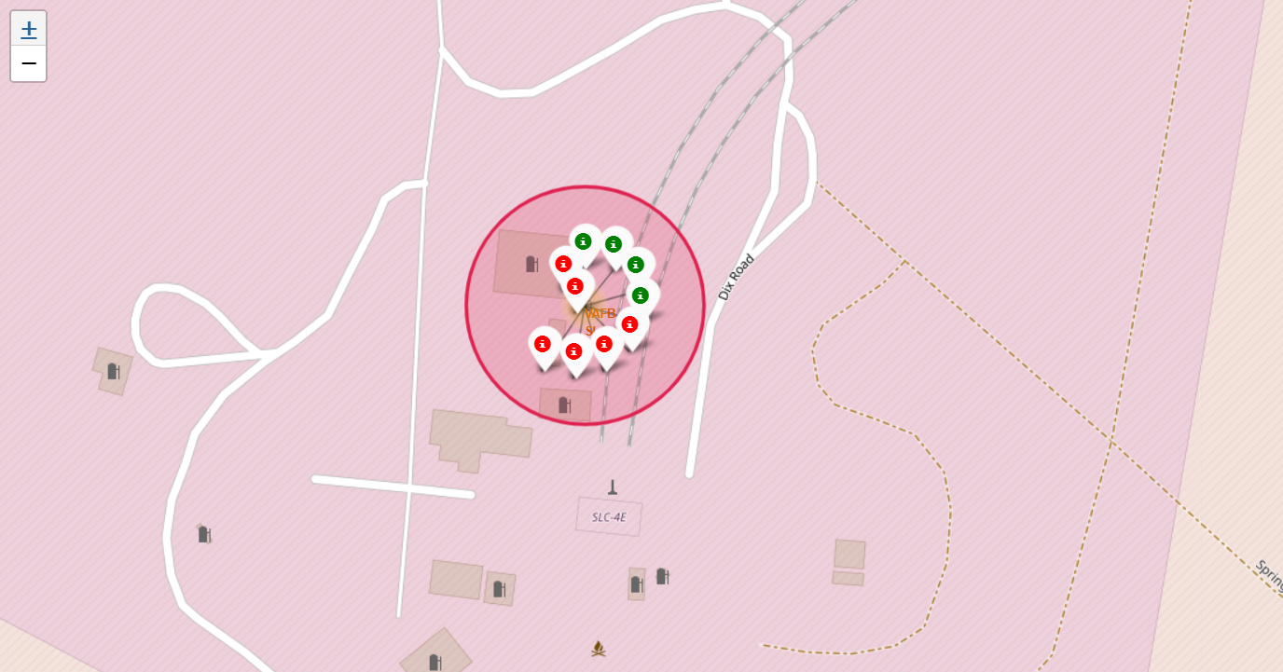
Results
Interactive Visual Analytics using Folium
Task 2: Marking Successful and Failed Launches for all launch sites

Slide 19
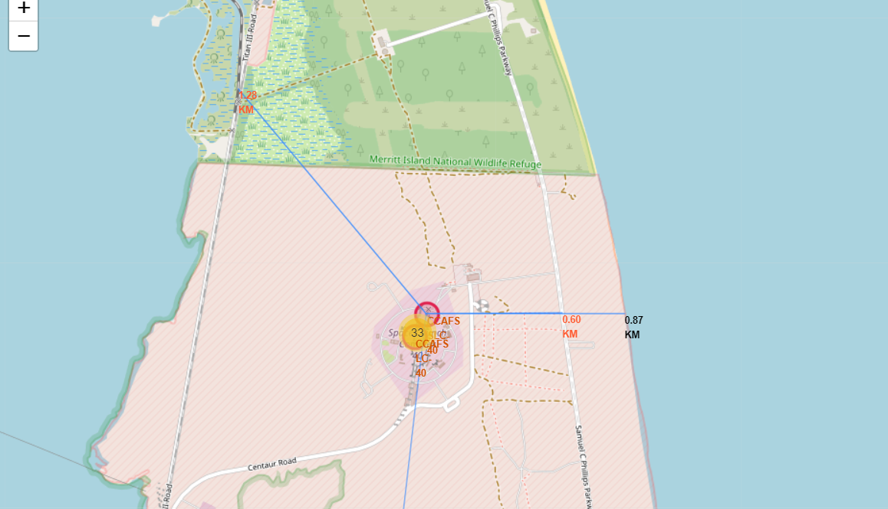
Results
Interactive Visual Analytics using Folium
Task 3: Calculating Distance between launch sites and its proximities with Polylines

Slide 20
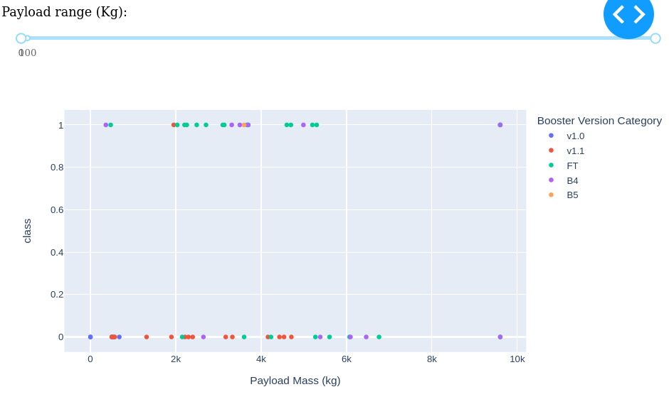
Results
Dash
Displaying Total Launches by Each Site via a Pie Chart
Interactive visualisation with varying Payload Range

Slide 21
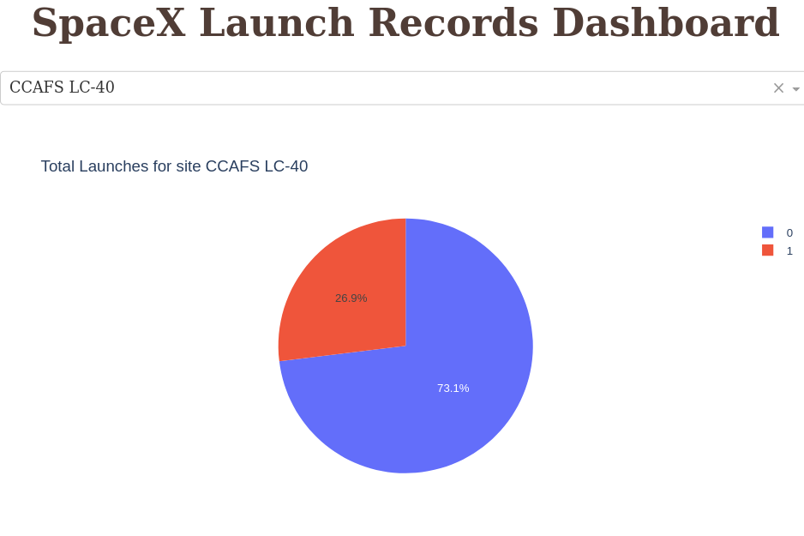
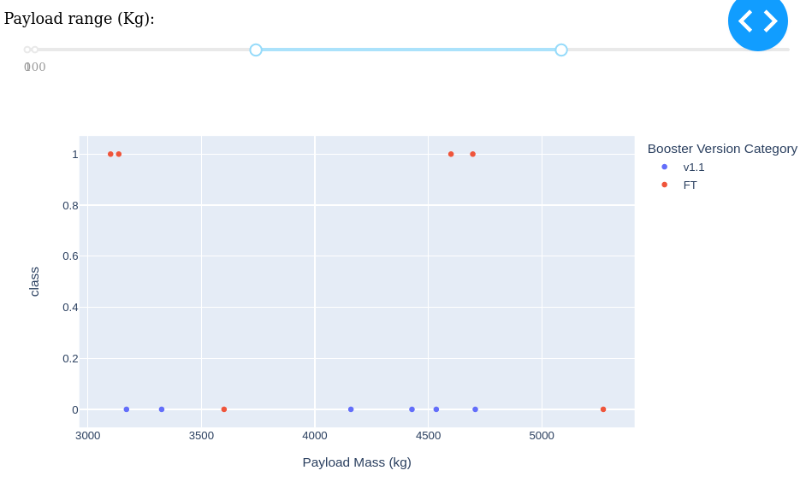
Results
Dash
Displaying Total Launches by CCAFS LC-40 Site
Displaying booster classes carrying payload between 3000Kgs and 5500 Kgs

Slide 22
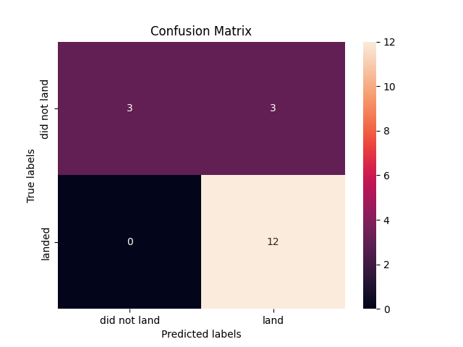
Results
Predictive Model
Logistic Regression:
Training Accuracy : 83.33%
Test Accuracy : 84.64%
Section Vector Machine(SVM):
Training Accuracy : 83.33%
Test Accuracy : 84.82%
Logistic Regression Confusion Matrix
SVM Confusion Matrix

Slide 23
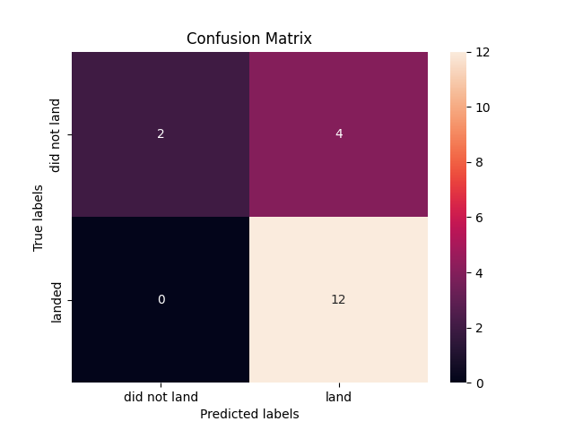
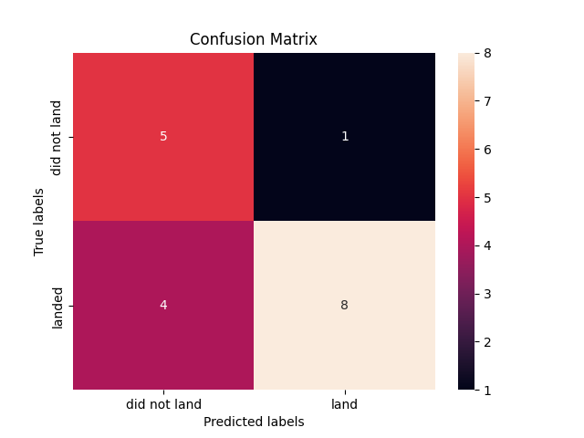
Results
Predictive Model
Decision Tree:
Training Accuracy : 77.77%
Test Accuracy : 88.92%
K Nearest Neighbour (KNN):
Training Accuracy : 72.22%
Test Accuracy : 90.35%
Decision Tree Confusion Matrix
KNN Confusion Matrix

Slide 24
Discussion
From the results it could be observed that there might be some relation among the features with the mission outcome. For example, with heavy payloads the successful landing or positive landing rate are more for orbit types Polar, LEO and ISS. However, for GTO, we cannot distinguish this well as both positive landing rate and negative landing(unsuccessful mission) are both there here.
With further improvement in the algorithm used for pre-processing techniques and to train the machine learning models, we could obtain better insight into correlation among the features. Techniques like correlation analysis, data bivariate and multivariate analysis, and data augmentation may prove to improve our understanding of the data and help in knowledge discovery.

Slide 25
Conclusion
In this Capstone, we tried to identify the mission outcomes of the Falcon9 SpaceX rockets based on environmental and rocket attributes.
From the analysis of data it was identified that site KSC LC-39A had the best record of successful launches and that launches with Payload mass above 7000Kgs were less risky.
Furthermore, an increasing trend of successful launches can be observed from 2013 onwards, with a slight dip in 2018.
From the predictive model, KNN proved to be the best to fit on the test data to identify potential of success for a launch mission.

